Slide 1
Week 10
Keel Bone Chicken Project
10/31/2025

Slide 2
This Week
Progress this week
CSV Script for Data
Visit to Agriculture Farm
Modifications to Battery System

Slide 3
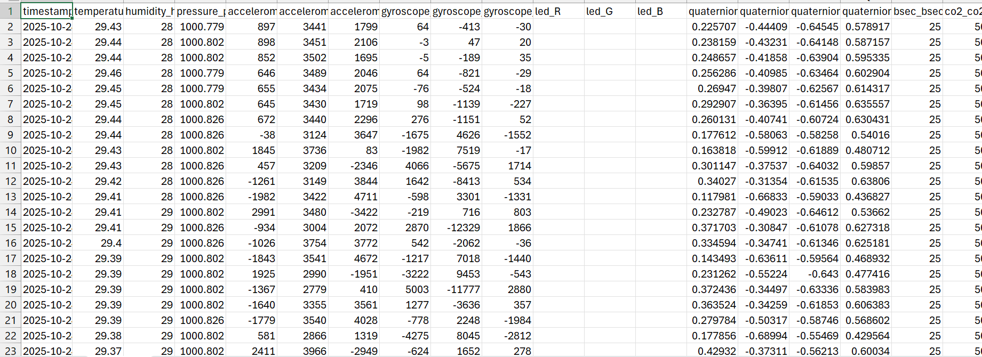
CSV Script for Data
Original .CSV file from last week:
CSV file generated from local WebBLE interface

Slide 4
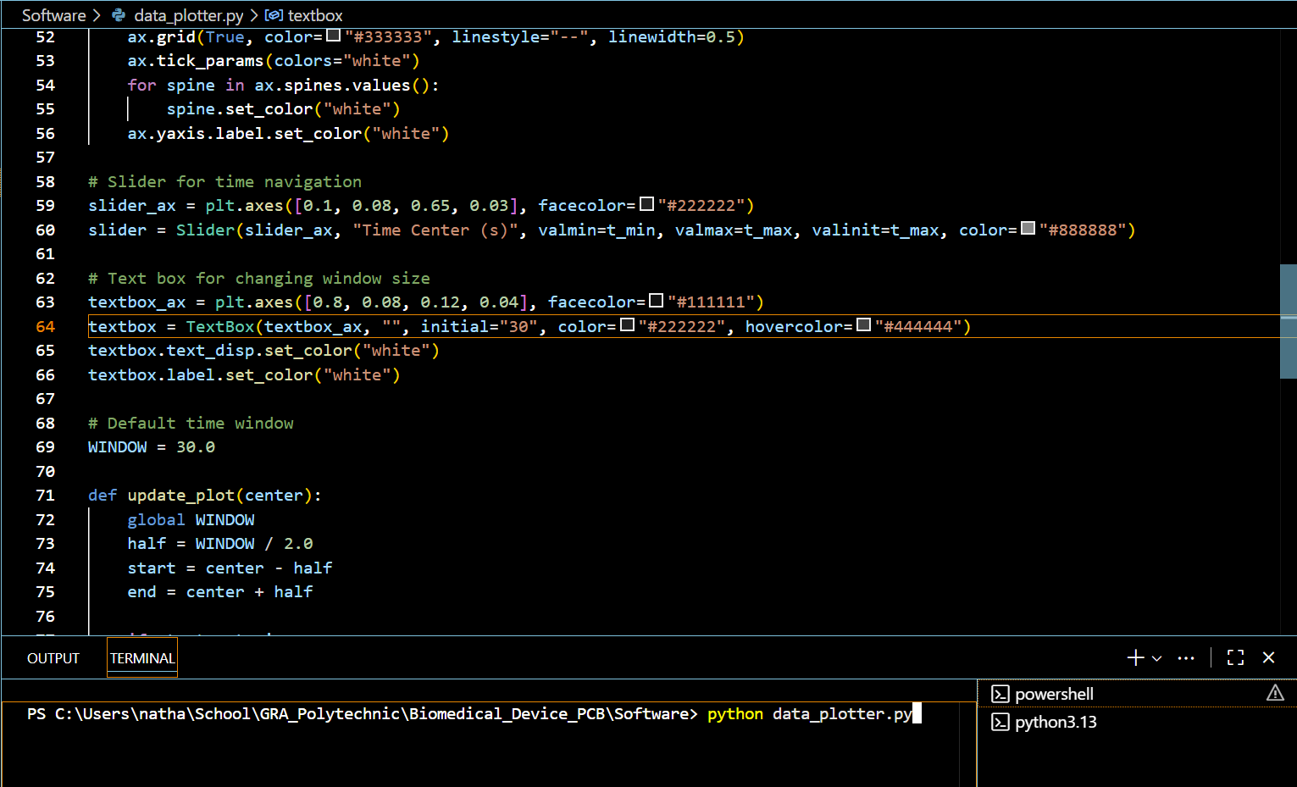
CSV Script for Data
Able to extract data for longer quantities
Extract data into subplots and plots.

Slide 5
CSV Script for Data
Generates the following Matplotlib file
Sliding window for time analysis
All plots (Strain, Force, Temperature, Gyroscope) can be generated

Slide 6
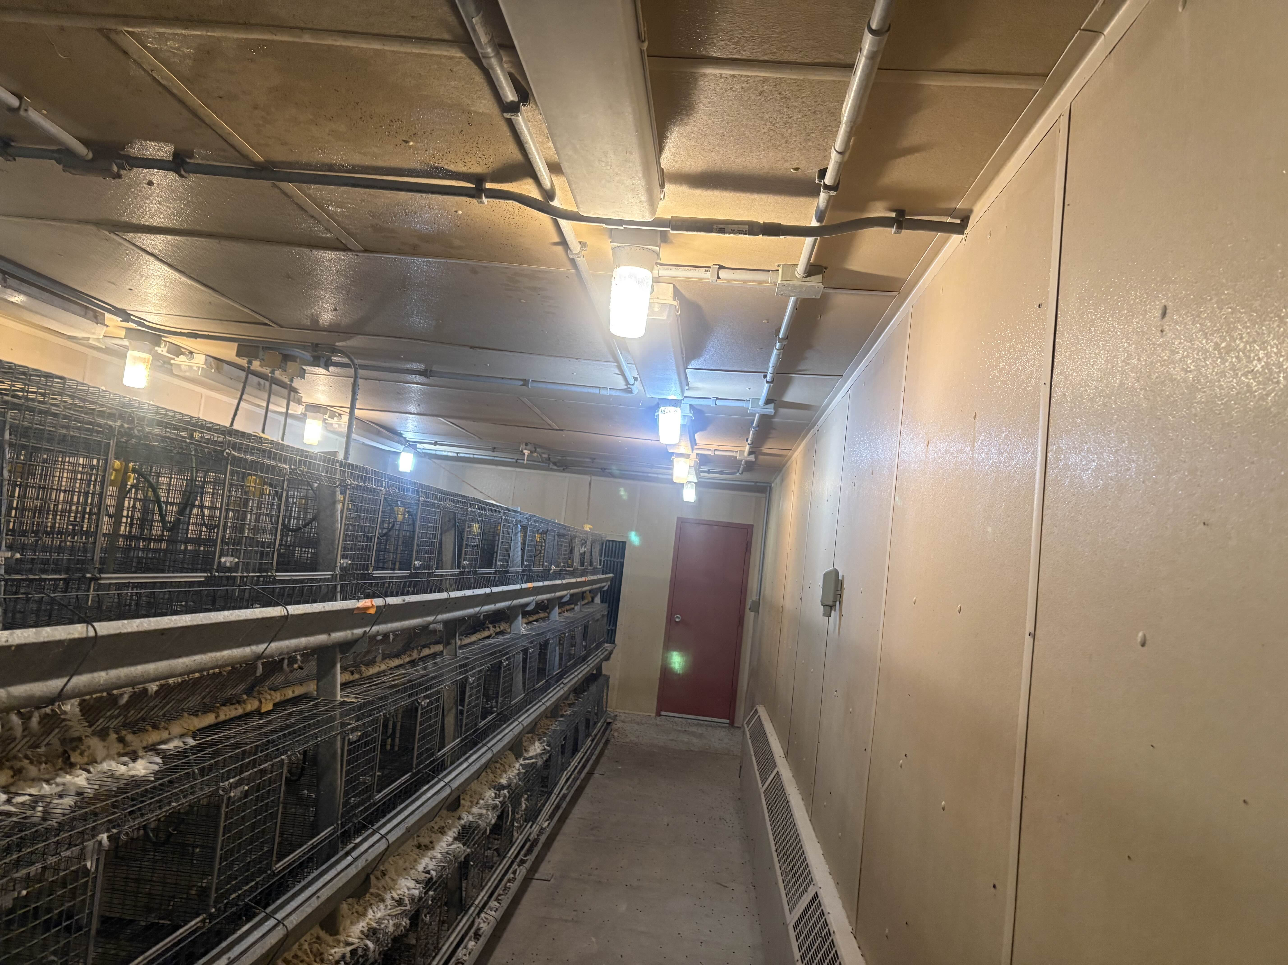
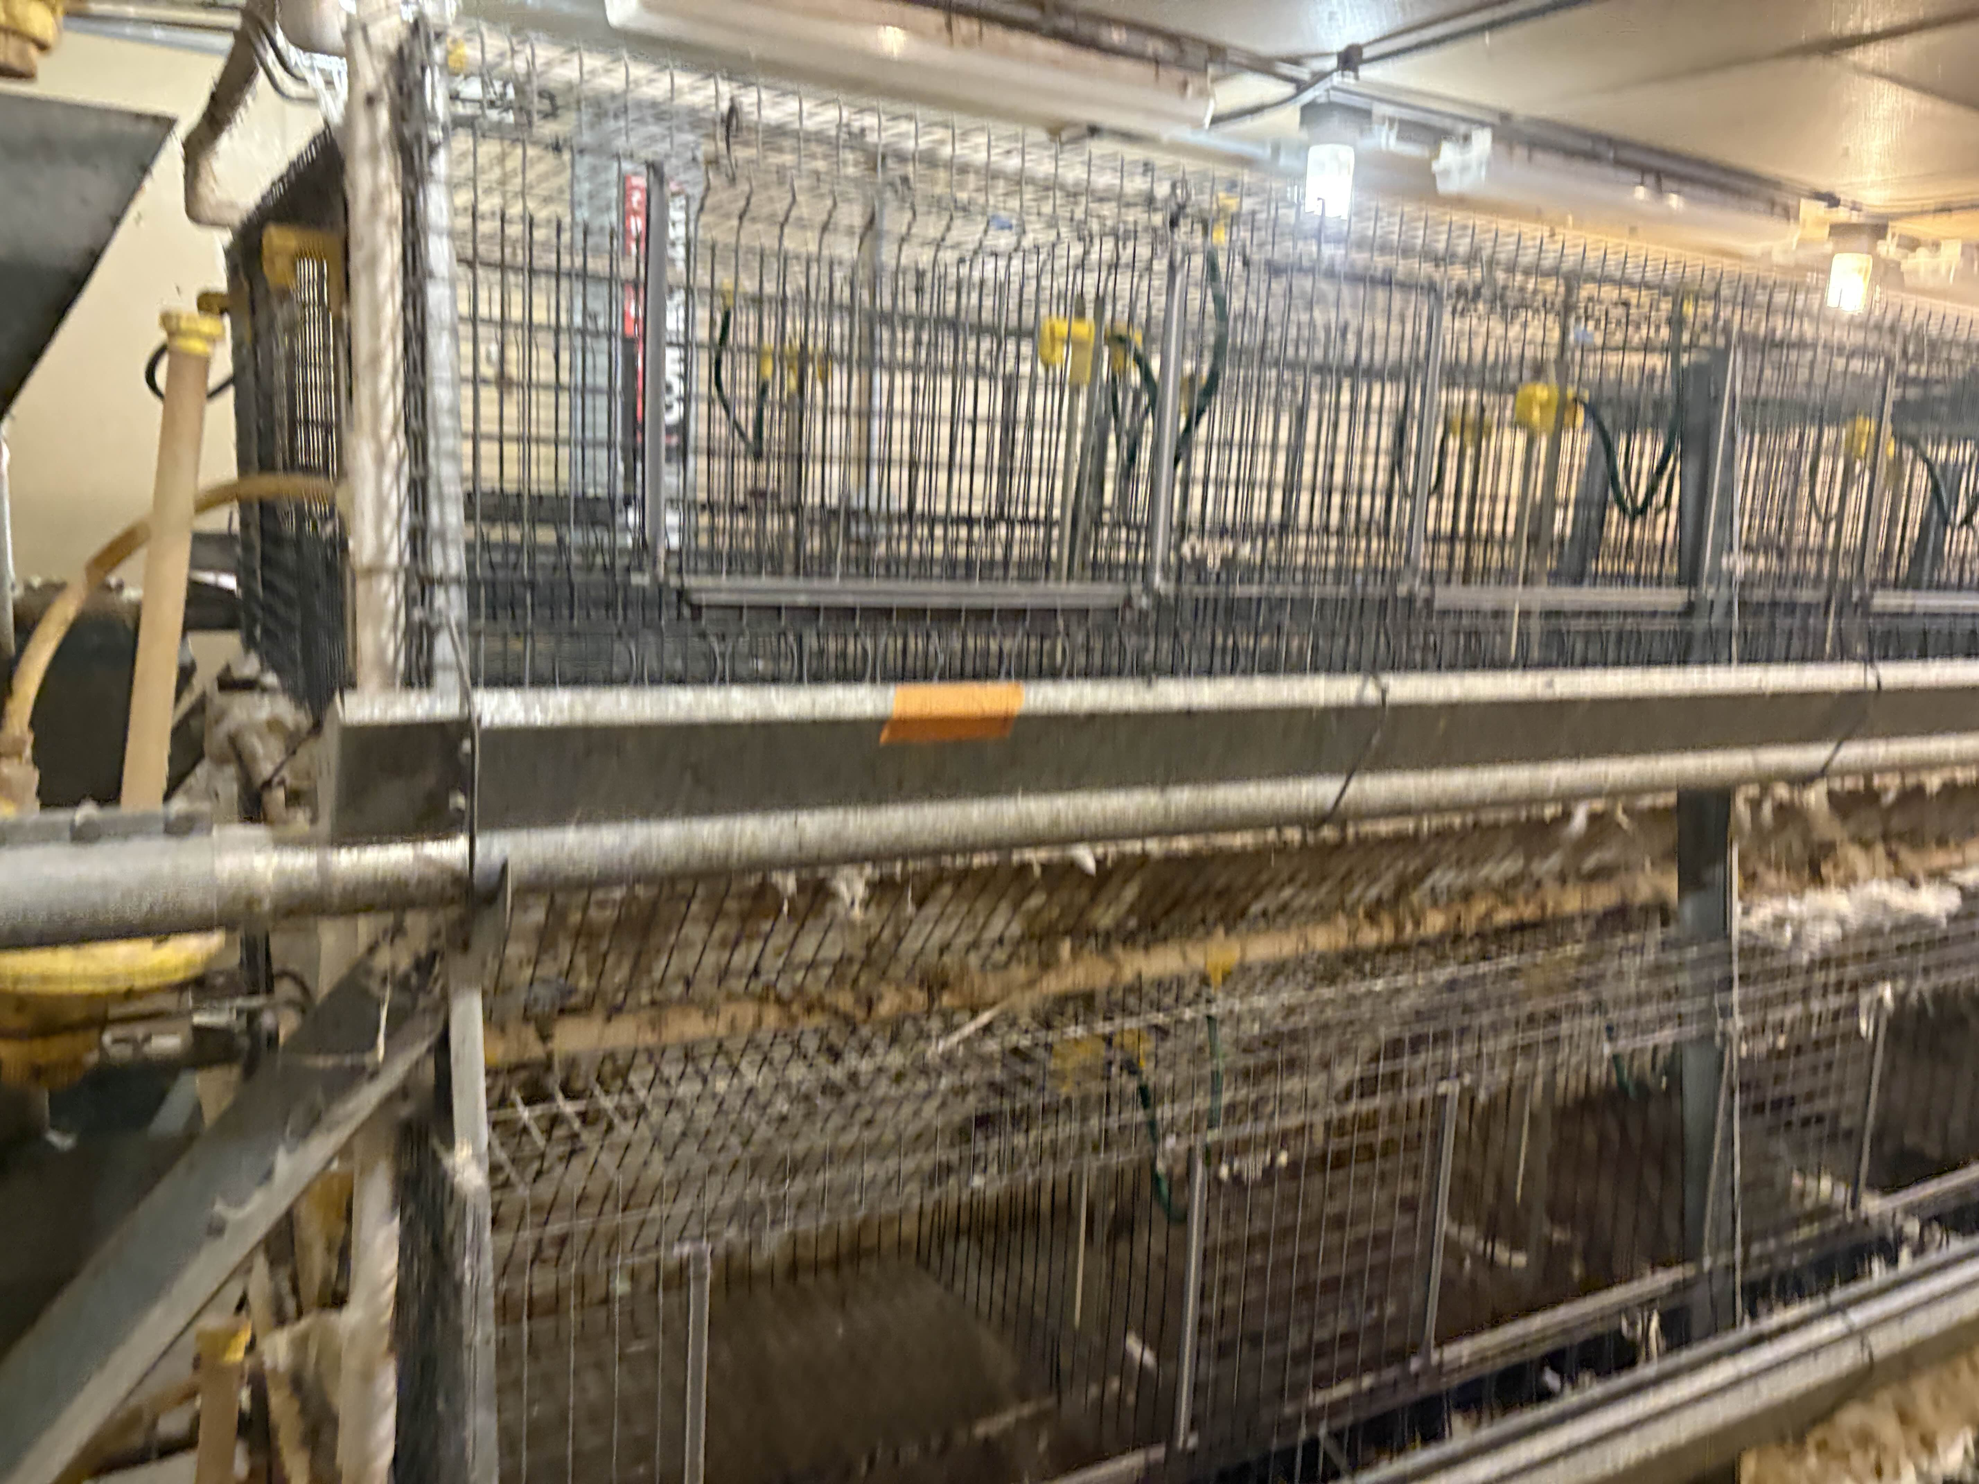
Visit to Agriculture Farm
Understanding of testing conditions for chickens
Cages arranged in rows
1, 2, 3 rows for testing
3-Tier Testing System
Approximate Volume

Slide 7
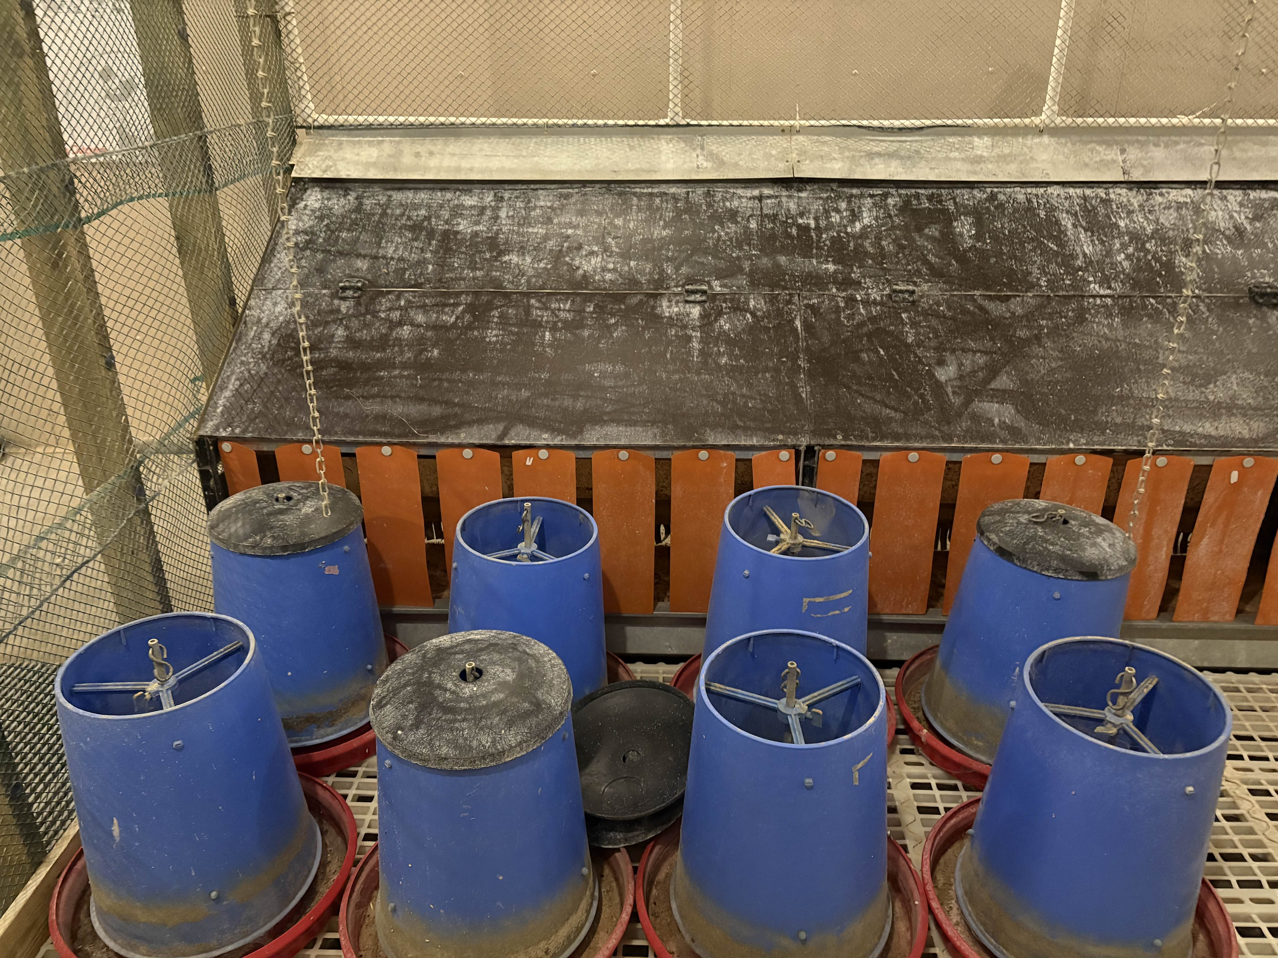
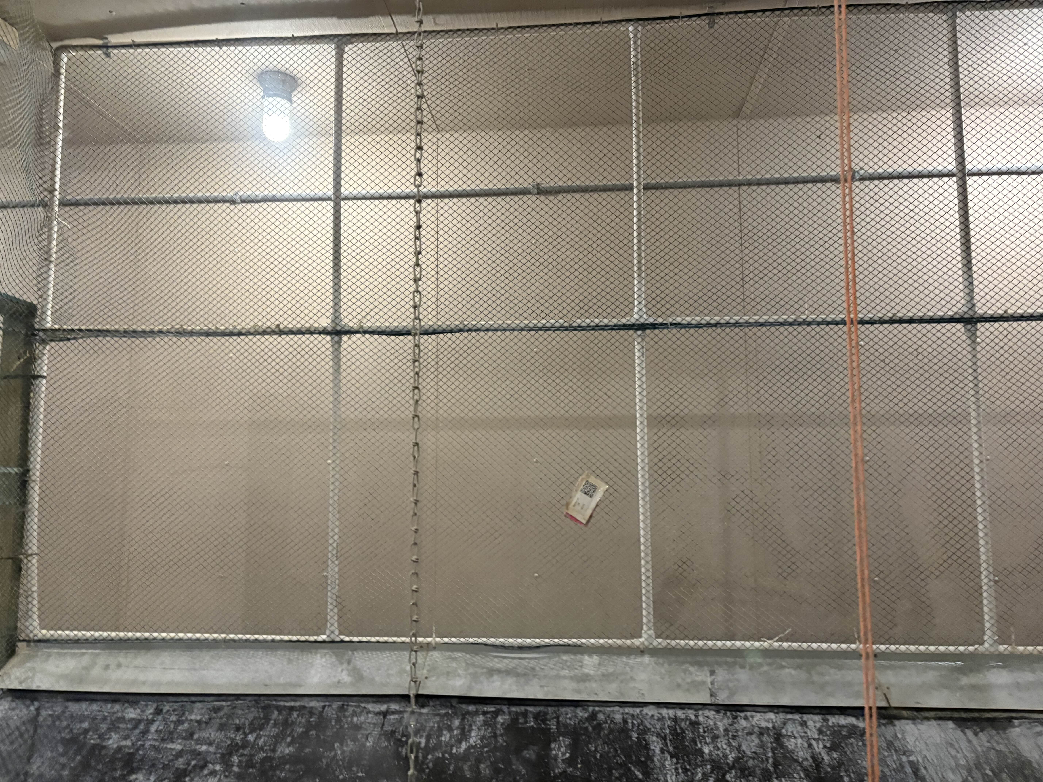
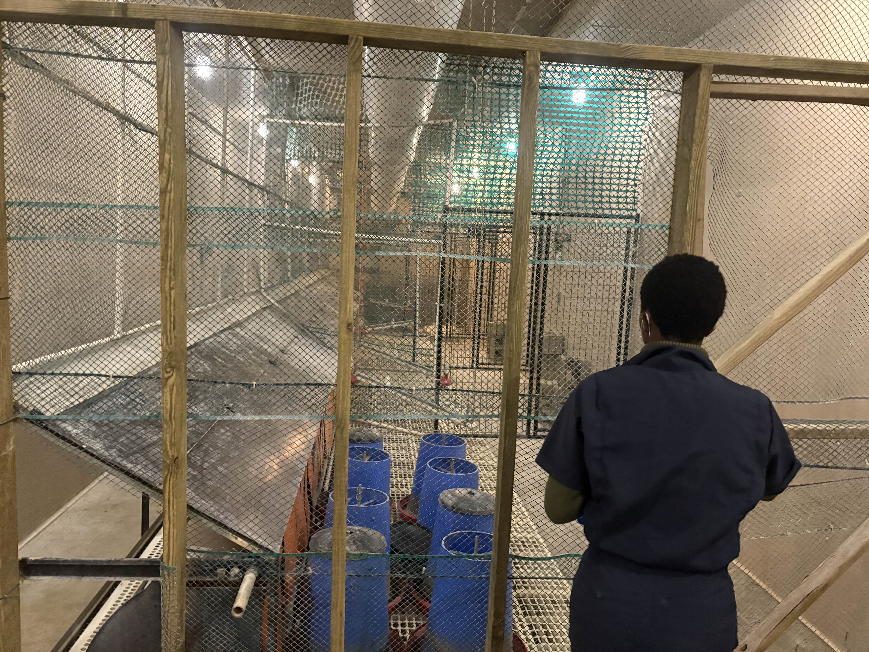
Visit to Agriculture Farm
Modifications to Battery System
Very little capacity for Solar charging (artificial light)
Small space for RFID charging with remote power near wall?
Need to find alternative solution within testing constraints, or larger battery is needed

Slide 8
Next Week
Blockers & Next Week’s Work
Analysis of Solar/RFID range charging
Verify Charge amplifier circuit
Obtain testing data from agriculture department
Train agriculture representative on how to obtain data
Blockers:
Thinking of alternatives to supply energy to the device
Nicla Logging only logs the last 60 seconds of values (potential could need a fix to this issue)

Slide 9
Thank You
Purdue Polytechnic Institute

